Slide 1
Predicting Song Genre
With Supervised Learning

Slide 2
Project Outline
Q: How accurately can a song’s genre be predicted given its musical attributes?
EDA
Analyze musical features
Duplicate track listings
“Speechiness” attribute (removing non-musical tracks)
Feature Engineering I
Highly correlated features
Class distribution (class imbalance?)
Modelling I
Data preparation (one-hot, drop ID)
Baseline test 1
Feature Engineering II
External data (artist country)
Modelling II
Baseline test 2
Model Optimization
Optimal parameters (GridSearch)
ROC
Conclusion

Slide 3
Intro
The Spotify API provides musical data for every track in its database. This includes concrete attributes such as track duration and tempo, and arbitrary estimations such as danceability and energy.
Using these provided attributes and the addition of the country of origin of the artist of a track, the aim is to predict the genre of a song as accurately as possible.
In addition to music, Spotify’s library includes a diverse collection of audio tracks which include podcasts, stand-up comedy sets and movie/TV show monologues distributed throughout each genre. An important caveat of this project is that the intention is to classify musical tracks only into their respective genres.

Slide 4
EDA

Slide 5
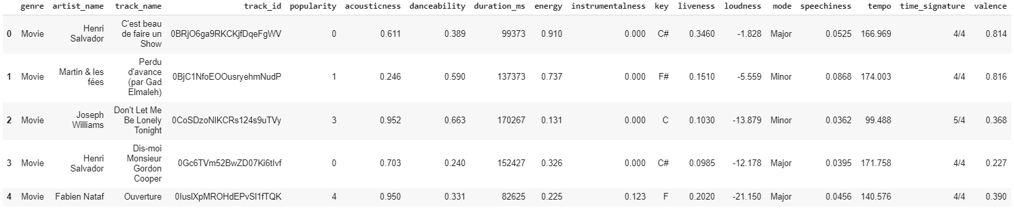
Dataframe (original)

Slide 6
Arbitrary Features
These are arbitrary estimations about a track’s sound, produced by Spotify.
Feature | Description | Type
acousticness | The estimated acousticness of a track | Float (0.0 - 1.0)
danceability | How suitable the track is for dancing | Float (0.0 - 1.0)
energy | The estimated measure of intensity of a track | Float (0.0 - 1.0)
instrumentalness | Measure of vocal content of a track | Float (0.0 - 1.0)
liveness | The presence of an audience in the recording (whether it’s a live recording) | Float (0.0 - 1.0)
speechiness | The presence of spoken words in a track | Float (0.0 - 1.0)
valence | The musical positiveness conveyed by a track | Float (0.0 - 1.0)

Slide 7
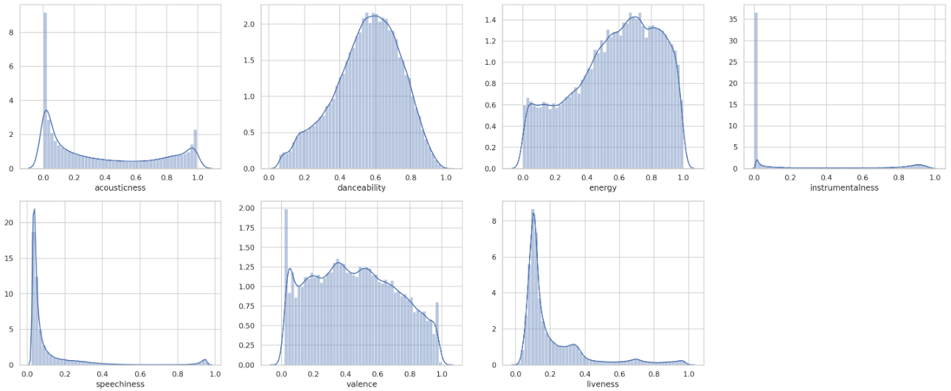
Arbitrary Feature Distributions

Slide 8
Concrete Features
These are factual (or “concrete”) attributes of each track.
Feature | Description | Type
duration_ms | The duration of the track in milliseconds | Integer (continuous)
key | The estimated overall key of the track | String (categorical)
mode | The modality (major or minor) of a track | String (categorical)
time_signature | The estimated overall time signature of a track | String (categorical)
loudness | The overall loudness of a track in decibels (dB) | Float (continuous)
tempo | The overall estimated tempo of a track in beats per minute (BPM) | Float (continuous)

Slide 9
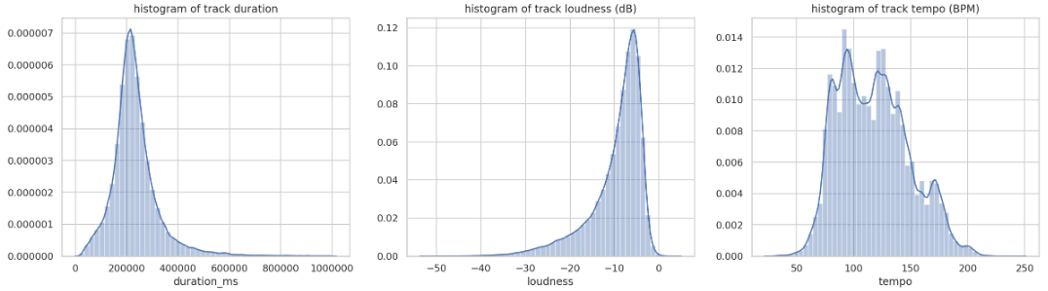
Distribution of Concrete, Continuous Features
Duration distribution centered around 200,000 milliseconds (3.33 minutes)
Loudness averages around -6dB, maxes out around 0dB
Tempo normally distributed but with peaks at specific BPM ranges

Slide 10
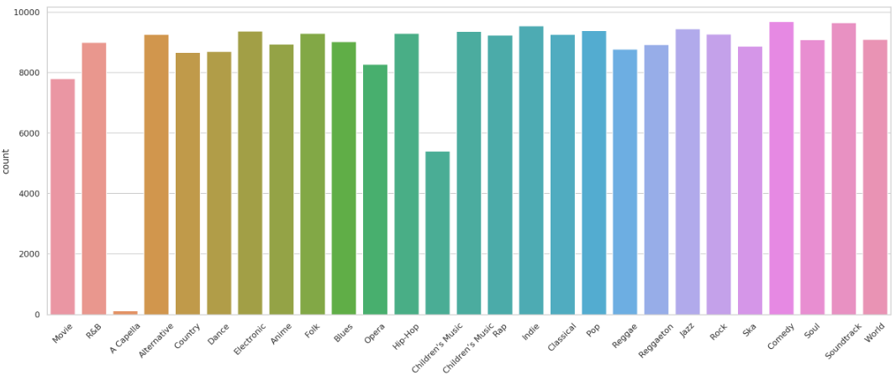
Genre Distribution
Fairly even genre representation (by design of data collection)
Very low A Capella representation (uncommon genre)
Double entry for Children’s Music (addressed in data cleaning)

Slide 11
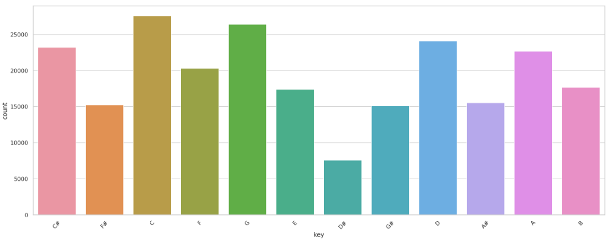
Key Distribution
Low D# representation (consistent with D# commonality in music)
C, G, D most common

Slide 12
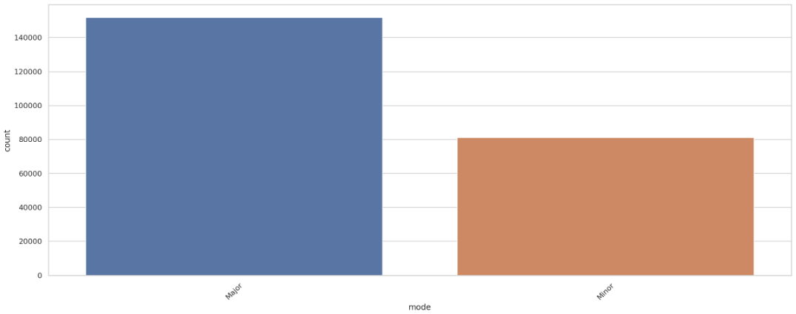
Mode Distribution
Major scales more common than minor

Slide 13
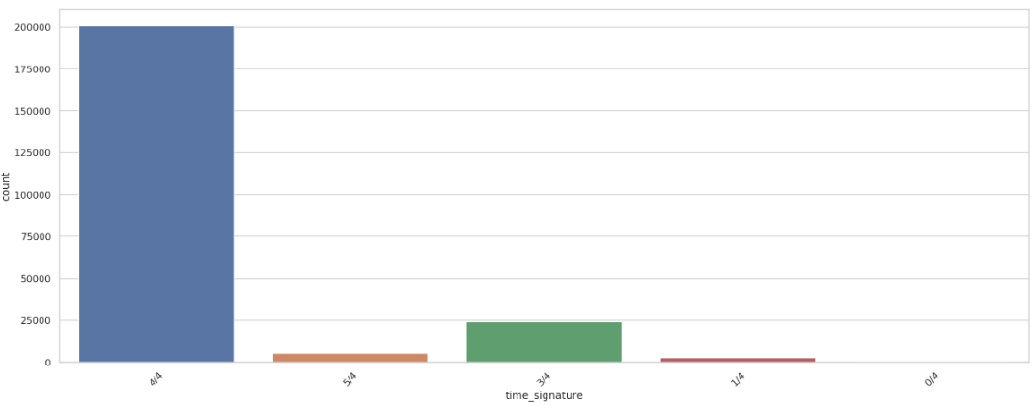
Time Signature Distribution
4/4 most common
1/4 and 0/4 don’t generally exist in music (addressed in data cleaning)

Slide 14
Data Cleaning

Slide 15
Data Cleaning Summary
Two different labels for Children’s Music
Children's Music vs. Children’s Music
Removed one w/ less representation
0/4 and 1/4 tracks were mislabeled
Removed all
16% duplicate track entries
Songs listed under multiple genres
Removed all
Spoken word tracks (speechiness)
Determined cutoff
(cont’d next slide)

Slide 16
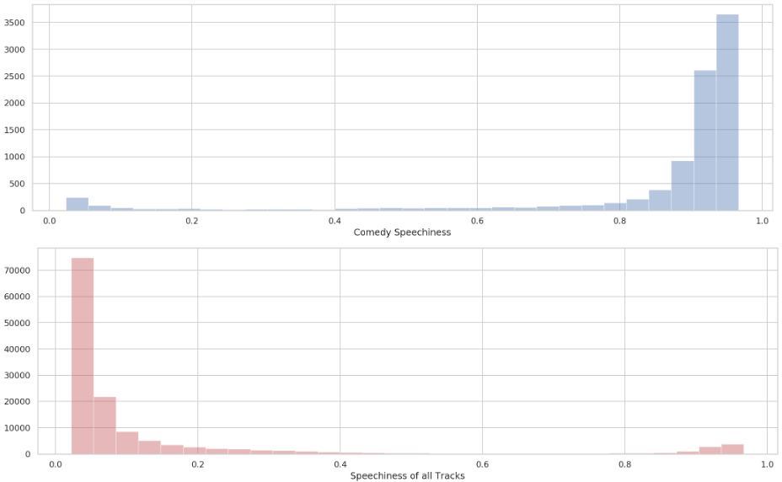
Speechiness Cleaning
Comedy tracks were found to have a high “speechiness” attribute, since a majority are stand-up comedy sets, not songs

Slide 17
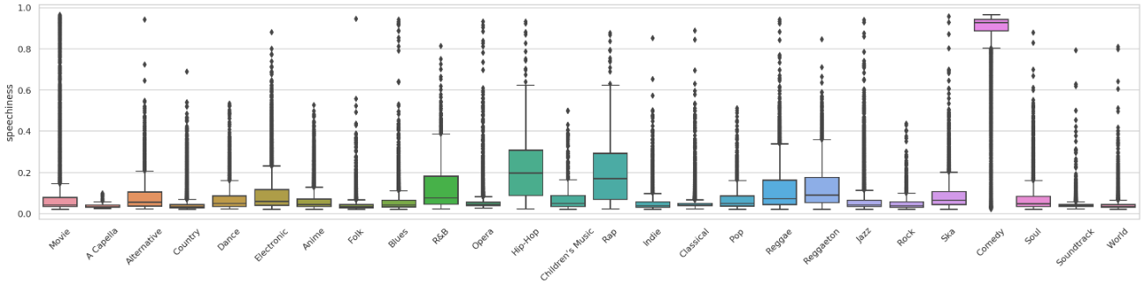
Speechiness Cleaning (cont’d)
This led to investigating speechiness for all tracks
The goal is to remove all tracks that are spoken word, in order to only analyze actual songs
Determined cutoff at 0.6
Max speechiness for Hip-Hop and R&B, the two next most speech-heavy genres

Slide 18
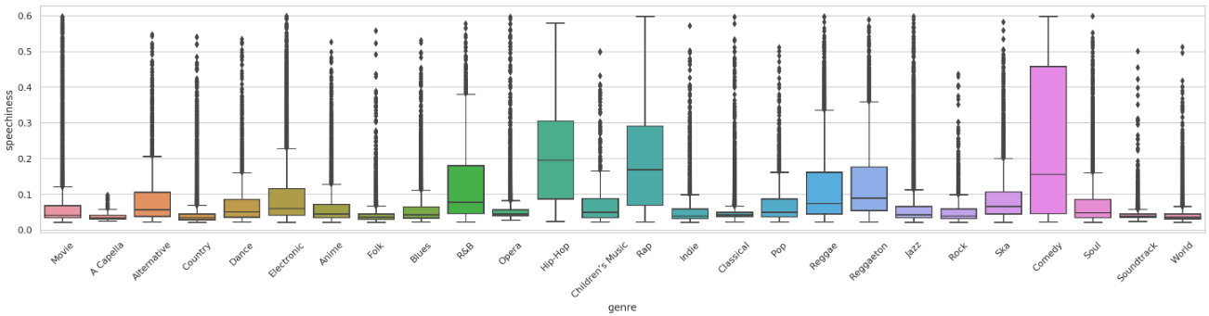
Speechiness Cleaning (cont’d)
Distribution after removal (songs only)
Spotify’s official docs state spoken word tracks start at ~0.66 speechiness
I was close!

Slide 19
Feature Engineering I

Slide 20
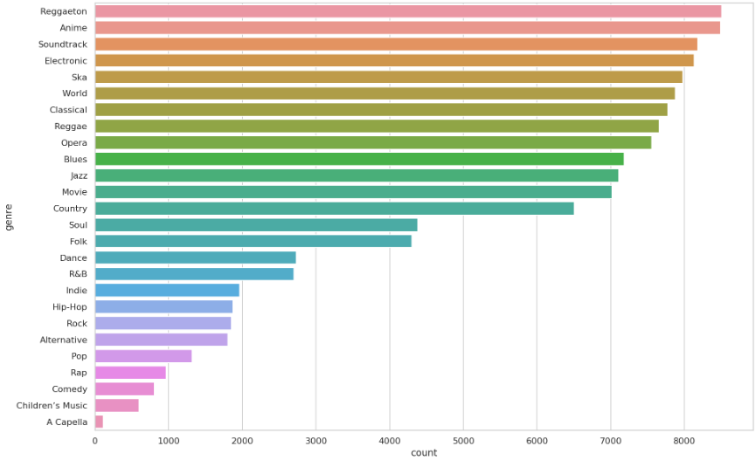
Class Distribution
Classes imbalanced after removing spoken-word tracks
Can see which genres had the most spoken-word tracks
Rebalancing classes would lead to large data loss

Slide 21
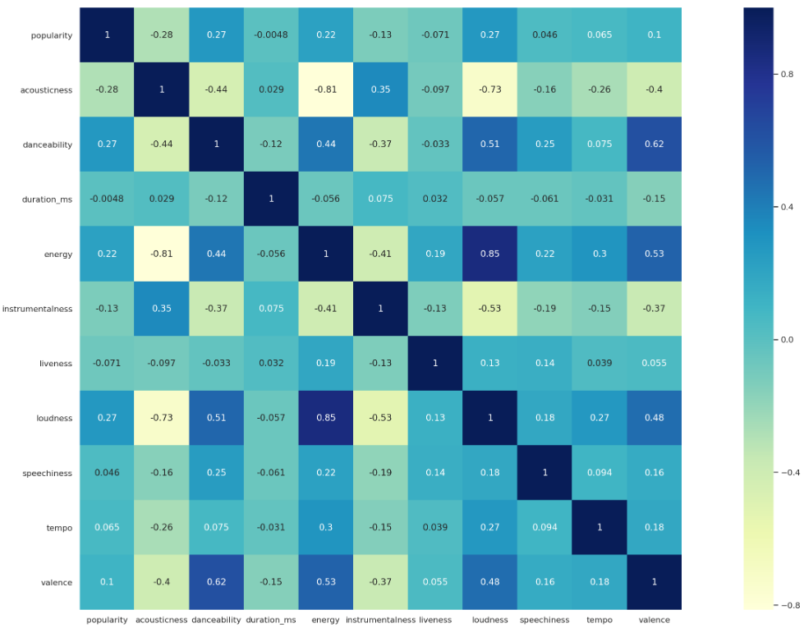
Feature Heatmap
Observations:
Energy & Loudness have 0.85 correlation
Danceability & Valence have 0.62 correlation
Danceability & Loudness have 0.51 correlation
Rule of thumb is > 0.8, therefore will address the Energy & Loudness correlation

Slide 22
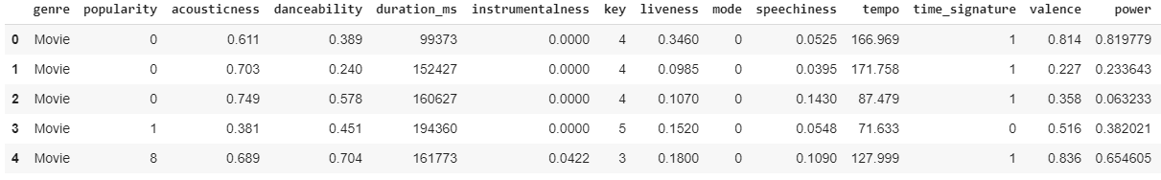
New Feature
Energy & loudness combined into “Power” feature

Slide 23
Modelling I

Slide 24
Baseline Test I (default parameters)
Model | Train Accuracy | Test Accuracy | Train Log Loss | Test Log Loss
Logistic Regression | 0.113 | 0.114 | 2.944 | 2.944
Random Forest Classifier | 1.0 | 0.556 | 0.284 | 1.754
K Nearest Neighbor Classifier | 0.366 | 0.118 | 1.347 | 22.096
Gradient Boosting Classifier | 0.566 | 0.536 | 1.408 | 1.529
Random Forest has highest accuracy
Possibly overfitting
Gradient Boosting has least error on test set

Slide 25
Feature Engineering II

Slide 26
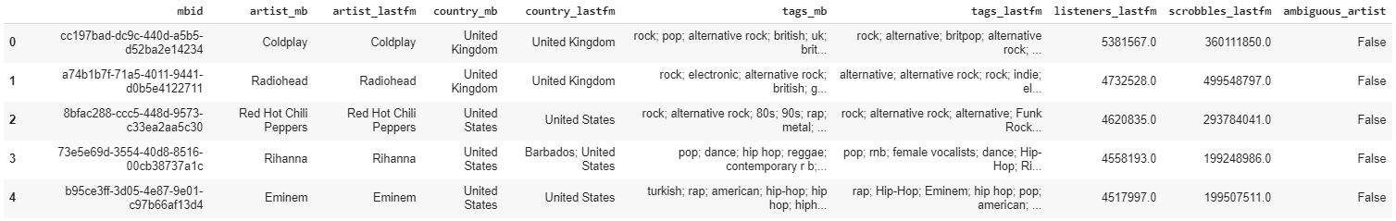
Artist Info Dataset
Dataset contains artist data from last.fm and musicbrainz.com
Interested in artist country to improve genre predictions

Slide 27
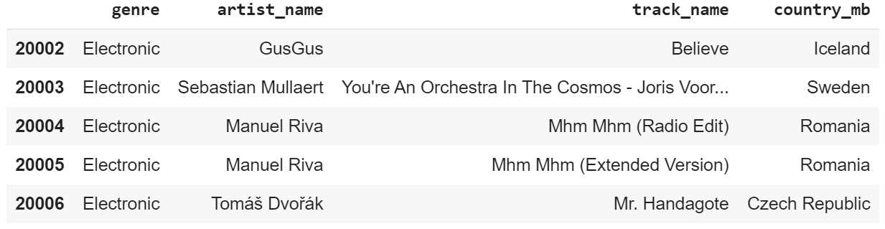
Dataframe w/ Country

Slide 28
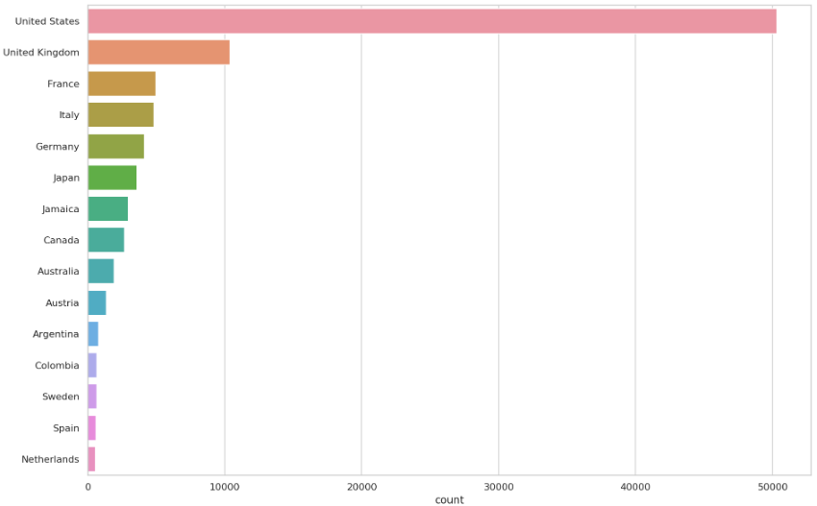
Country Distribution

Slide 29
Modelling II

Slide 30
Baseline Test II
Model | Train Accuracy | Test Accuracy | Train Log Loss | Test Log Loss
Logistic Regression | 0.129 | 0.125 | 2.915 | 2.920
Random Forest Classifier | 1.0 | 0.651 | 0.251 | 1.422
K Nearest Neighbor Classifier | 0.364 | 0.114 | 1.350 | 22.304
Gradient Boosting Classifier | 0.673 | 0.640 | 1.075 | 1.172
Addition of artist country shows improvement of ~0.10 for random forest
0.556 -> 0.651
Log loss decreased as well (random forest)

Slide 31
Model Optimization

Slide 32
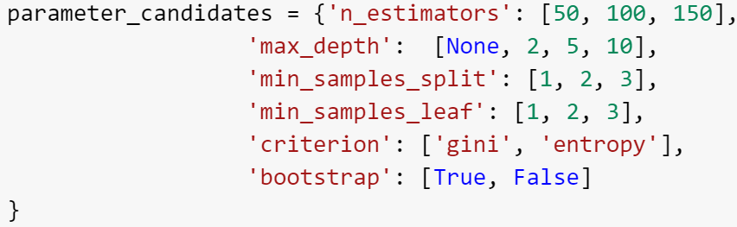
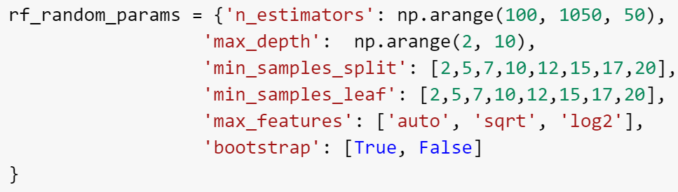
GridSearch & RandomizedSearch (random forest)
Ran multiple GridSearch and RandomSearch (example parameters above)
No significant improvements on default parameters

Slide 33
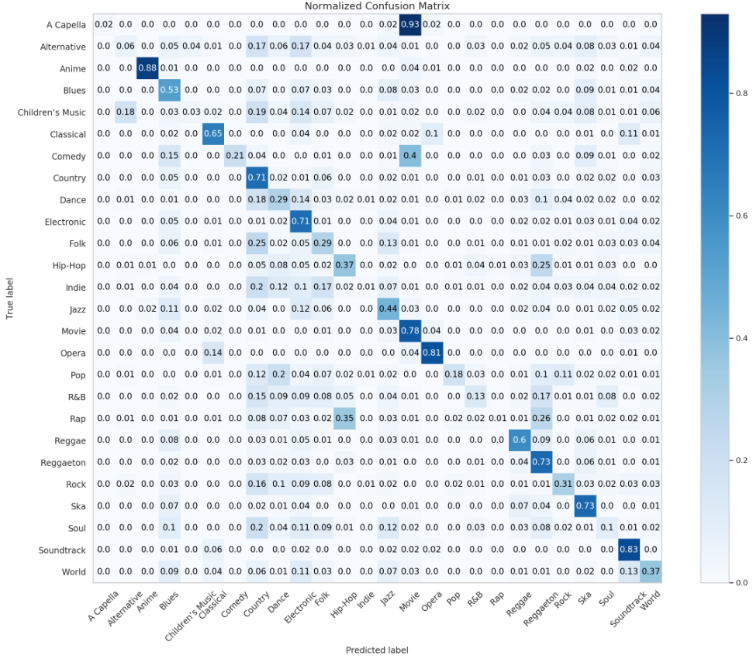
Normalized Confusion Matrix (random forest)
Fairly weak performance overall
Model good (>.80) at identifying:
Anime
Opera
Soundtrack
Model ok (>.70) at identifying:
Country
Electronic
Movie
Reggaeton
Ska
Mediocre (>.60) at identifying:
Classical
Reggae

Slide 34
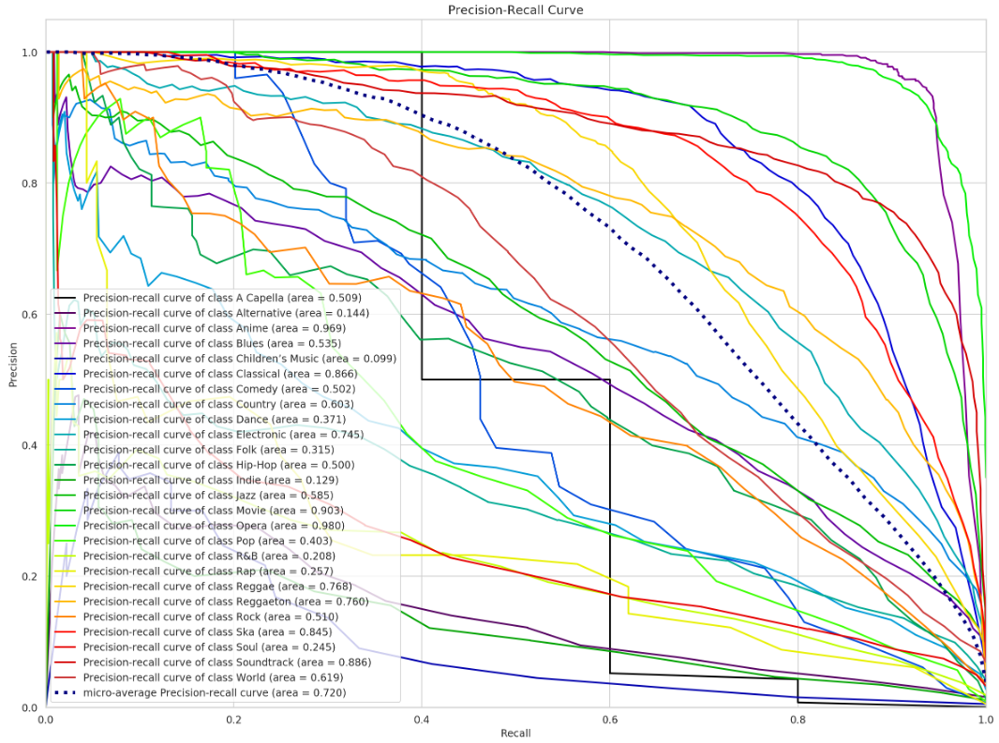
Precision-Recall Curve
Another way of visualizing individual class prediction accuracy
Too many classes to keep track of here

Slide 35
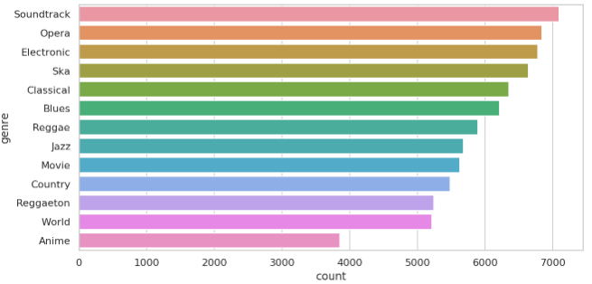
Solution
High amount of classes (genres) is making models overfit
Will reduce classes to see how models improve
Iteratively cut # of classes in half
26 -> 13 classes

Slide 36
13 Classes
Model | Train Accuracy | Test Accuracy | Train Log Loss | Test Log Loss
Logistic Regression | 0.178 | 0.176 | 2.404 | 2.404
Random Forest Classifier | 1.0 | 0.750 | 0.189 | 0.886
K Nearest Neighbor Classifier | 0.425 | 0.180 | 1.229 | 17.475
Gradient Boosting Classifier | 0.786 | 0.749 | 0.646 | 0.748
Gradient boosting now almost yields same accuracy as random forest

Slide 37
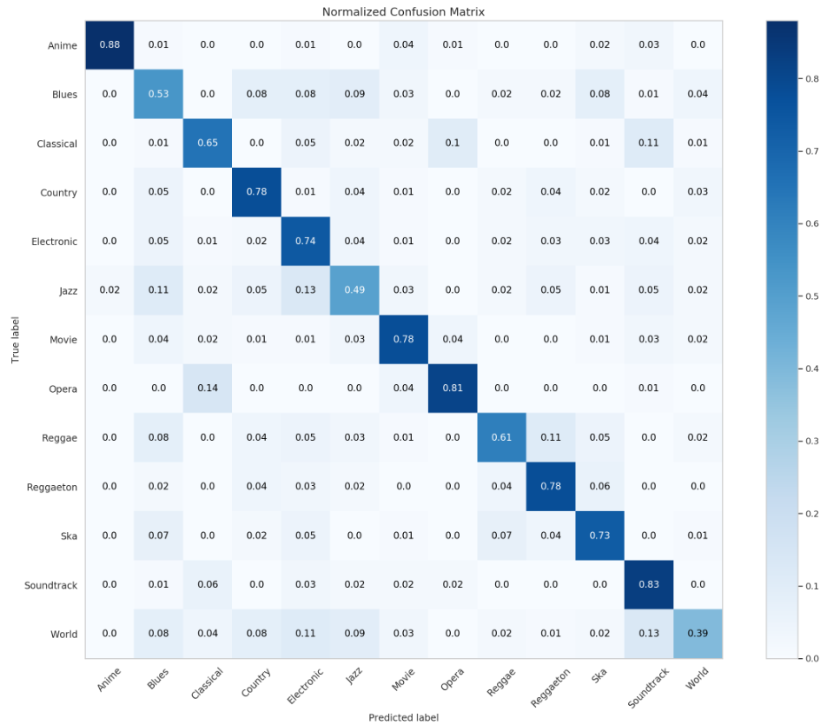
Normalized Confusion Matrix (13 classes)
Much improved performance
Model good (>.80) at identifying:
Anime
Opera
Soundtrack
Model ok (>.70) at identifying:
Country
Electronic
Movie
Reggaeton
Ska
Mediocre (>.60) at identifying:
Classical
Reggae

Slide 38
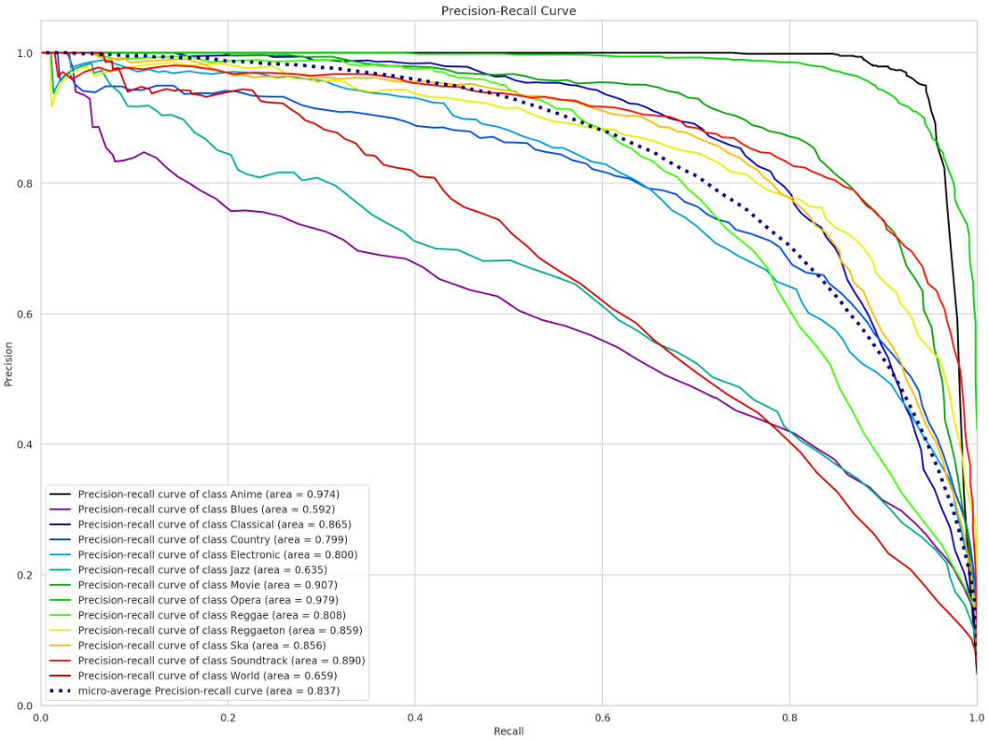
Precision-Recall Curve (13 classes)
Manageable amount of classes
We can see anime was the most accurately predicted
Blues was the least accurate

Slide 39
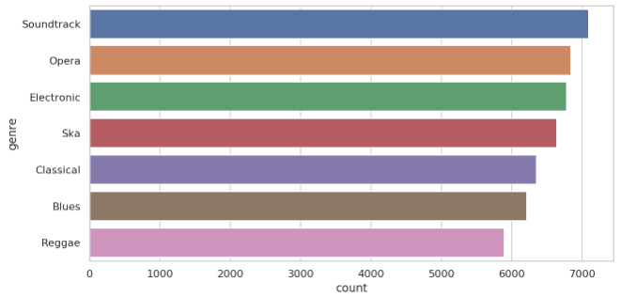
7 Classes
Gradient boosting still just behind random forest in accuracy
Model | Train Accuracy | Test Accuracy | Train Log Loss | Test Log Loss
Logistic Regression | 0.348 | 0.345 | 1.676 | 1.694
Random Forest Classifier | 0.999 | 0.835 | 0.131 | 0.538
K Nearest Neighbor Classifier | 0.508 | 0.275 | 1.044 | 11.798
Gradient Boosting Classifier | 0.864 | 0.834 | 0.389 | 0.457

Slide 40
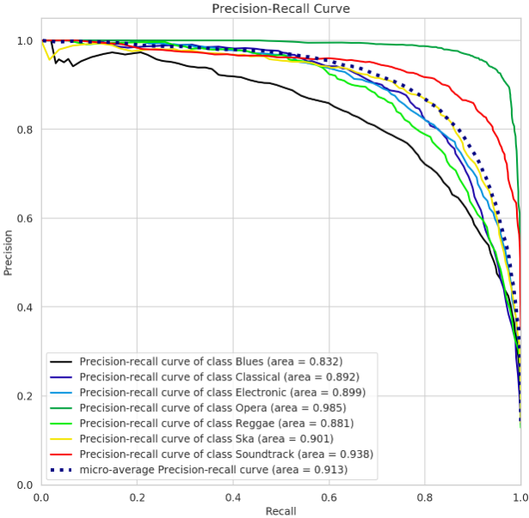
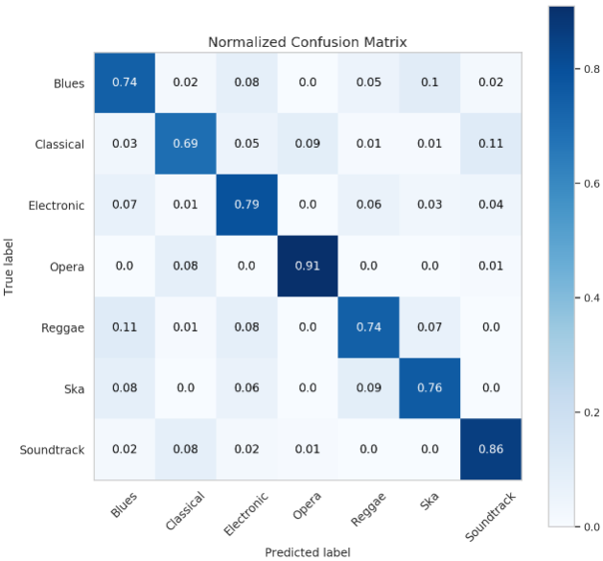
7 Classes

Slide 41
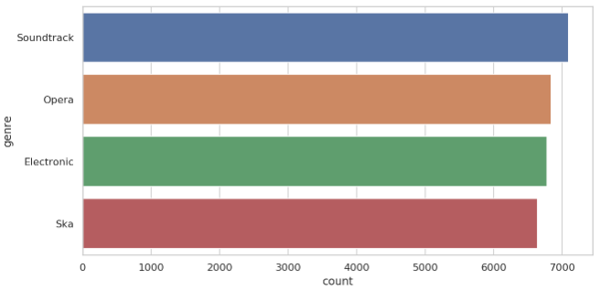
4 Classes
Gradient boosting now has highest test accuracy
Model | Train Accuracy | Test Accuracy | Train Log Loss | Test Log Loss
Logistic Regression | 0.530 | 0.526 | 1.109 | 1.115
Random Forest Classifier | 0.999 | 0.950 | 0.0532 | 0.177
K Nearest Neighbor Classifier | 0.613 | 0.418 | 0.797 | 6.179
Gradient Boosting Classifier | 0.967 | 0.951 | 0.096 | 0.137

Slide 42
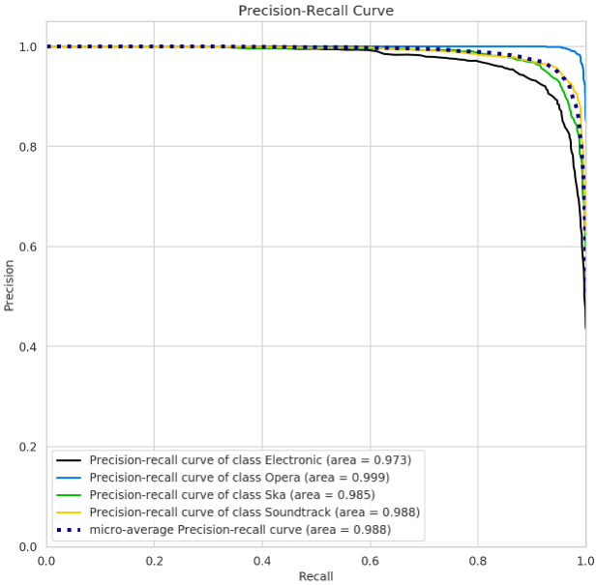
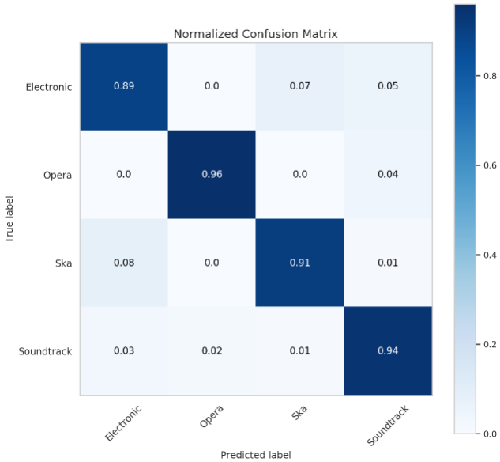
4 Classes

Slide 43
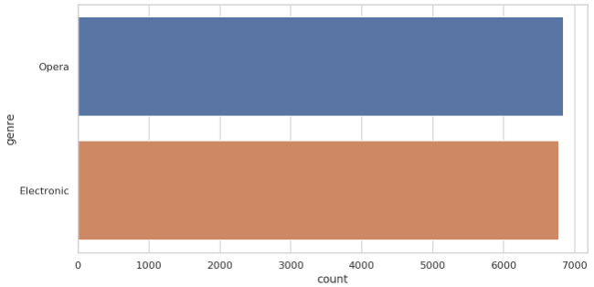
2 Classes (binary)
Random forest and gradient boosting tied for accuracy
Gradient boosting has less error
Model | Train Accuracy | Test Accuracy | Train Log Loss | Test Log Loss
Logistic Regression | 0.887 | 0.903 | 0.295 | 0.276
Random Forest Classifier | 1.0 | 0.996 | 0.004 | 0.016
K Nearest Neighbor Classifier | 0.782 | 0.634 | 0.441 | 1.798
Gradient Boosting Classifier | 1.0 | 0.996 | 0.0005 | 0.008

Slide 44
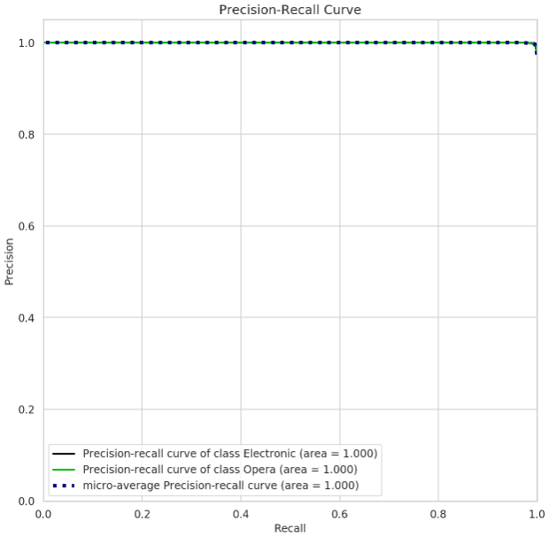
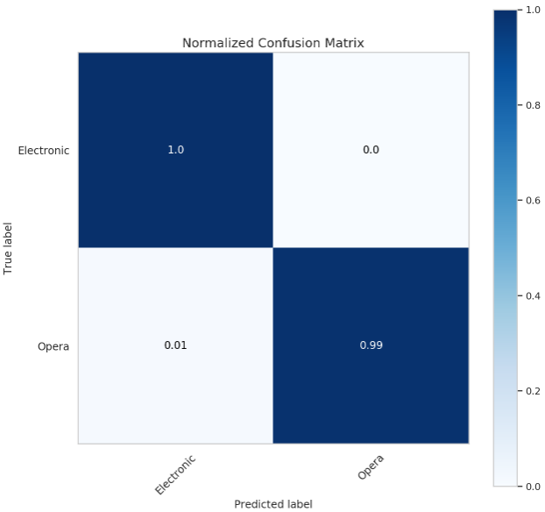
2 Classes (binary)

Slide 45
Conclusion

Slide 46
Results Summary
I found that the high amount of classes (genres) I was trying to classify tracks into severely hurt the model’s performance and led to overfitting
During further testing, by reducing the amount of genres, I was able to achieve accuracies upwards of 90%, and when classifying between just two genres, some models were almost 100% accurate.
While the amount of classes made achieving a great performance impossible, the addition of artist country proved to be beneficial, improving models by about 10%

Slide 47
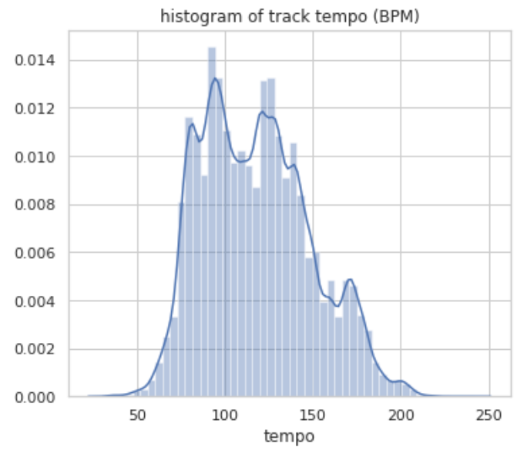
Further Optimization
Condense genres into categories
Add additional data to balance genres
Add tracks of genres with higher proportions of spoken-word tracks
Add more track features such as song release year
Common BPM ranges can be used to help determine genre

Slide 48
Use Cases
Determining genre of a track
Can be useful when creating playlists, categorizing music
Dataset can provide insights on what types of music different countries produce, which genres are the most popular, etc.

